Slide 1
Programming and Data Structures
Encryption Modes

Slide 2
Multiple Encryption & DES
clear a replacement for DES was needed
theoretical attacks that can break it
demonstrated exhaustive key search attacks
AES is a new cipher alternative
prior to this alternative was to use multiple encryption with DES implementations
Triple-DES is the chosen form
Notes:
2
Given the potential vulnerability of DES to a brute-force attack,there has been considerable interest in finding an alternative. One approach is to design a completely new algorithm, of which AES is a prime example. Another alternative, which would preserve the existing investment in software and equipment, is to use multiple encryption with DES and multiple keys. We examine the widely accepted triple DES (3DES) approach.

Slide 3
Why not Double-DES?
could use 2 DES encrypts on each block
C = E_{K2}(E_{K1}(P))
concern at time of reduction to single stage
“meet-in-the-middle” attack
works whenever use a cipher twice
since X = E_{K1}(P) = D_{K2}(C)
attack by encrypting P with all keys and store
then decrypt C with keys and match X value
can show takes O(2⁵⁶) steps
Requires…
known plaintext
Notes:
3
The simplest form of multiple encryption has two encryption stages and two keys - Double-DES.
Have concern that there might be a single key that is equivalent to using 2 keys as above, not likely but only finally proved as impossible in 1992.
More seriously have the “meet-in-the-middle” attack, first described by Diffie in 1977. It is a known plaintext attack (ie have know pair (P,C), and attempts to find by trial-and-error a value X in the “middle” of the double-DES encryption of this pair, and chances of this are much better at O(2^56) than exhaustive search at O(2^112).

Slide 4
Triple-DES with Two-Keys
hence must use 3 encryptions
would seem to need 3 distinct keys
but can use 2 keys with E-D-E sequence
C = E_{K1}(D_{K2}(E_{K1}(P)))
n.b. encrypt & decrypt equivalent in security
if K1=K2 then can work with single DES
standardized in ANSI X9.17 & ISO8732
no current known practical attacks
several proposed impractical attacks might become basis of future attacks
Notes:
4
Triple-DES with two keys is a popular alternative to single-DES, but suffers from being 3 times slower to run. The use of encryption & decryption stages are equivalent, but the chosen structure allows for compatibility with single-DES implementations. 3DES with two keys is a relatively popular alternative to DES and has been adopted for use in the key management standards ANS X9.17 and ISO 8732. Currently, there are no practical cryptanalytic attacks on 3DES. Coppersmith notes that the cost of a brute-force key search on 3DES is on the order of 2^112 (=5*10^33) and estimates that the cost of differential cryptanalysis suffers an exponential growth, compared to single DES, exceeding 10^52.
There are several proposed attacks on 3DES that, although not currently practical, give a flavor for the types of attacks that have been considered and that could form the basis for more successful future attacks. See text for details.

Slide 5
Triple-DES with Three-Keys
although are no practical attacks on two-key Triple-DES have some indications
can use Triple-DES with Three-Keys to avoid even these
C = E_{K3}(D_{K2}(E_{K1}(P)))
has been adopted by some Internet applications, e.g., PGP, S/MIME
Notes:
5
Although the attacks currently known appear impractical, anyone using two-key 3DES may feel some concern. Thus, many researchers now feel that three-key 3DES is the preferred alternative. Three-key 3DES has an effective key length of 168 bits and is defined as shown. A number of Internet-based applications have adopted three-key 3DES, including PGP and S/MIME.

Slide 6
Modes of Operation
block ciphers encrypt fixed size blocks
e.g., DES encrypts 64-bit blocks
need some way to en/decrypt arbitrary amounts of data in practice
NIST SP 800-38A defines 5 modes
have block and stream modes
to cover a wide variety of applications
can be used with any block cipher
Notes:
6
DES (or any block cipher) forms a basic building block, which en/decrypts a fixed sized block of data. However to use these in practise, we usually need to handle arbitrary amounts of data, which may be available in advance (in which case a block mode is appropriate), and may only be available a bit/byte at a time (in which case a stream mode is used). To apply a block cipher in a variety of applications, five "modes of operation" have been defined by NIST (SP 800-38A). In essence, a mode of operation is a technique for enhancing the effect of a cryptographic algorithm or adapting the algorithm for an application, such as applying a block cipher to a sequence of data blocks or a data stream. The five modes are intended to cover a wide variety of applications of encryption for which a block cipher could be used. These modes are intended for use with any symmetric block cipher, including triple DES and AES. .

Slide 7
https://en.wikipedia.org/wiki/Block_cipher_mode_of_operation

Slide 8
Electronic Codebook Book (ECB)
message is broken into independent blocks that are encrypted
each block is a value which is substituted, like a codebook, hence name
each block is encoded independently of the other blocks
C_{i} = E_{K}(P_{i})
uses: secure transmission of single values
Notes:
8
The simplest mode is the electronic codebook (ECB) mode, in which plaintext is handled one block at a time and each block of plaintext is encrypted using the same key. The term codebook is used because, for a given key, there is a unique ciphertext for every b-bit block of plaintext. Therefore, we can imagine a gigantic codebook in which there is an entry for every possible b-bit plaintext pattern showing its corresponding ciphertext. For a message longer than b bits, the procedure is simply to break the message into b-bit blocks, padding the last block if necessary. Decryption is performed one block at a time, always using the same key. ECB is the simplest of the modes, and is used when only a single block of info needs to be sent (eg. a session key encrypted using a master key).

Slide 9
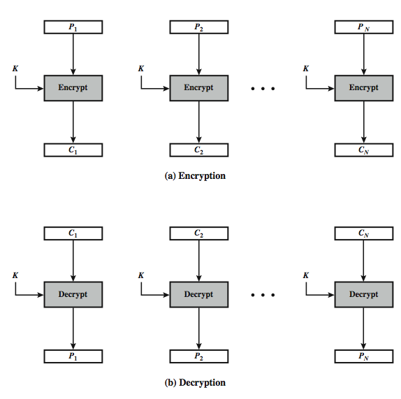
Electronic Codebook Book (ECB)
Notes:
9
Stallings Figure 6.3 illustrates the Electronic Codebook (ECB) Mode.

Slide 10
Advantages and Limitations of ECB
message repetitions may show in ciphertext
if aligned with message block
particularly with data such graphics
or with messages that change very little, which become a code-book analysis problem
weakness is due to the encrypted message blocks being independent
vulnerable to cut-and-paste attacks
main use is sending a few blocks of data
Notes:
10
For lengthy messages, the ECB mode may not be secure. If the message is highly structured, it may be possible for a cryptanalyst to exploit these regularities. If the message has repetitive elements, with a period of repetition a multiple of b bits, then these elements can be identified by the analyst. This may help in the analysis or may provide an opportunity for substituting or rearranging blocks. Hence ECB is not appropriate for any quantity of data, since repetitions can be seen, esp. with graphics, and because the blocks can be shuffled/inserted without affecting the en/decryption of each block. Its main use is to send one or a very few blocks, eg a session encryption key.

Slide 11
Cipher Block Chaining (CBC)
message is broken into blocks
linked together in encryption operation
each previous cipher block is chained with current plaintext block, hence name
use Initial Vector (IV) to start process
C_{i} = E_{K}(P_{i} XOR C_{i-1})
C₋₁ = IV
IV prevents same P from making same C
uses: bulk data encryption, authentication
Notes:
11
To overcome the problems of repetitions and order independence in ECB, want some way of making the ciphertext dependent on all blocks before it. The CBC provides this, by combining the previous ciphertext block with the current message block before encrypting. In effect, we have chained together the processing of the sequence of plaintext blocks. The input to the encryption function for each plaintext block bears no fixed relationship to the plaintext block. Therefore, repeating patterns of b bits are not exposed. For decryption, each cipher block is passed through the decryption algorithm. The result is XORed with the preceding ciphertext block to produce the plaintext block. To produce the first block of ciphertext, an initialization vector (IV) is XORed with the first block of plaintext. On decryption, the IV is XORed with the output of the decryption algorithm to recover the first block of plaintext. The IV is a data block that is that same size as the cipher block, and is either well known (often all 0's), or otherwise is sent, ECB encrypted, just before starting CBC use. CBC mode is applicable whenever large amounts of data need to be sent securely, provided that all data is available in advance (eg email, FTP, web etc).

Slide 12
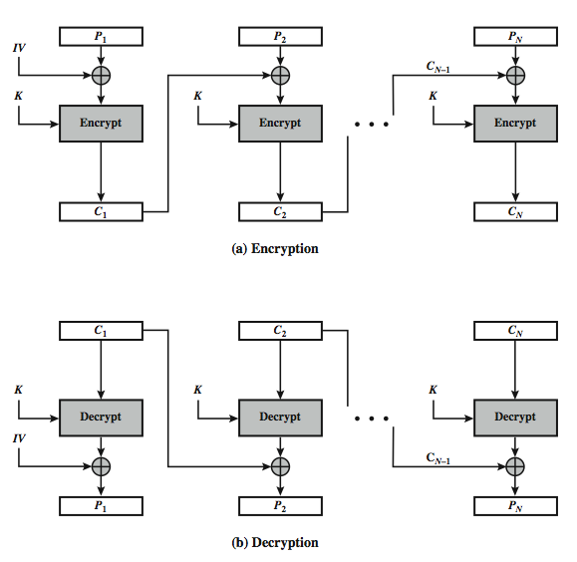
Cipher Block Chaining (CBC)
Notes:
12
Stallings Figure 6.4 illustrates the Cipher Block Chaining (CBC) Mode.

Slide 13
Message Padding
at end of message must handle a possible last short block
which is not as large as blocksize of cipher
pad either with known non-data value
e.g., nulls
or pad last block along with count of pad size
e.g., [ b1 b2 b3 0 0 0 0 5]
means have 3 data bytes, then 5 bytes pad+count
this may require an extra entire block over those in message
there are other, more esoteric modes, which avoid the need for an extra block
Notes:
13
One issue that arises with block modes is how to handle the last block, which may well not be complete. In general have to pad this block (typically with 0's), and then must recognise padding at other end - may be obvious (eg in text the 0 value should usually not occur), or otherwise must explicitly have the last byte as a count of how much padding was used (including the count). Note that if this is done, if the last block IS an even multiple of 8 bytes or has exactly the same form as pad+count, then will have to add an extra block, all padding so as to have a count in the last byte. There are other, more esoteric, “ciphertext stealing” modes, which avoid the need for an extra block.

Slide 14
Advantages and Limitations of CBC
a ciphertext block depends on all blocks before it
any change to a block affects all following ciphertext blocks...
need Initialization Vector (IV)
which must be known to sender & receiver
if sent in clear, attacker can change bits of first block, by changing corresponding bits of IV
hence IV must either be a fixed value (as in EFTPOS)
or derived in way hard to manipulate
or sent encrypted in ECB mode before rest of message
or message integrity must be checked otherwise
avalanche effect
Notes:
14
CBC is the block mode generally used. The chaining provides an avalanche effect, which means the encrypted message cannot be changed or rearranged without totally destroying the subsequent data. However there is the issue of ensuring that the IV is either fixed or sent encrypted in ECB mode to stop attacks on 1st block.

Slide 15
Stream Modes of Operation
block modes encrypt entire block
may need to operate on smaller units
real time data
convert block cipher into stream cipher
cipher feedback (CFB) mode
output feedback (OFB) mode
counter (CTR) mode
use block cipher as some form of pseudo-random number generator...
Vernam cipher
Notes:
For AES, DES, or any block cipher, encryption is performed on a block of b bits. However, it is possible to convert a block cipher into a stream cipher, using one of the three modes to be discussed in this and the next two sections: cipher feedback (CFB) mode, output feedback (OFB) mode, and counter (CTR) mode. A stream cipher eliminates the need to pad a message to be an integral number of blocks. It also can operate in real time. Thus, if a character stream is being transmitted, each character can be encrypted and transmitted immediately using a character-oriented stream cipher. Idea here is to use the block cipher essentially as a pseudo-random number, and to combine these "random" bits with the message. One desirable property of a stream cipher is that the ciphertext be of the same length as the plaintext. Thus, if 8-bit characters are being transmitted, each character should be encrypted to produce a ciphertext output of 8 bits. If more than 8 bits are produced, transmission capacity is wasted.
15

Slide 16
Cipher FeedBack (CFB)
message is treated as a stream of bits
added to the output of the block cipher
result is feed back for next stage (hence name)
standard allows any number of bits (1,8, 64 or 128 etc) to be feed back
denoted CFB-1, CFB-8, CFB-64, CFB-128, etc.
most efficient to use all bits in block (64 or 128)
C_{i} = P_{i} XOR E_{K}(C_{i-1})
C₋₁ = IV
uses: stream data encryption, authentication
Notes:
16
Cipher feedback (CFB) mode is one alternative. As with CBC, the units of plaintext are chained together, so that the ciphertext of any plaintext unit is a function of all the preceding plaintext. In this case, rather than units of b bits, the plaintext is divided into segments of s bits. The input to the encryption function is a b-bit shift register that is initially set to some initialization vector (IV). The leftmost (most significant) s bits of the output of the encryption function are XORed with the first segment of plaintext P1 to produce the first unit of ciphertext C1, which is then transmitted. In addition, the contents of the shift register are shifted left by s bits and C1 is placed in the rightmost (least significant) s bits of the shift register. This process continues until all plaintext units have been encrypted. For decryption, the same scheme is used, except that the received ciphertext unit is XORed with the output of the encryption function to produce the plaintext unit. Note that it is the encryption function that is used, not the decryption function.
As originally defined, CFB was to "consume" as much of the "random" output as needed for each message unit (bit/byte) before "bumping" bits out of the buffer and re-encrypting. This is wasteful though, and slows the encryption down as more encryptions are needed. An alternate way to think of it is to generate a block of "random" bits, consume them as message bits/bytes arrive, and when they're used up, only then feed a full block of ciphertext back. This is CFB-64 or CFB-128 mode (depending on the block size of the cipher used eg DES or AES respectively). CFB is the usual choice for quantities of stream oriented data, and for authentication use.

Slide 17
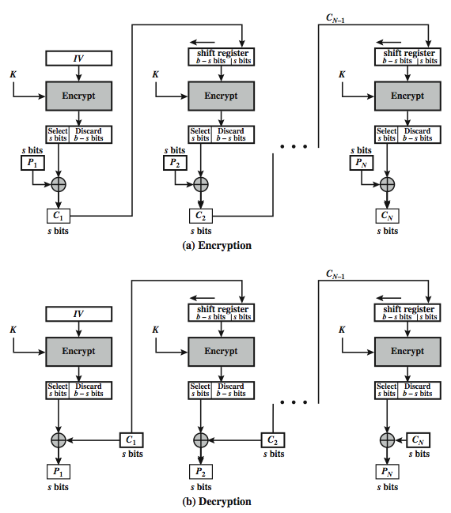
s-bit Cipher FeedBack (CFB-s)
Notes:
17
Stallings Figure 6.5 illustrates the operation of s-bit Cipher FeedBack (CFB) Mode.

Slide 18
Advantages and Limitations of CFB
most common stream mode
appropriate when data arrives in bits/bytes
limitation is need to stall while do block encryption after every s-bits
note that the block cipher is used in encryption mode at both ends (XOR)
errors propagate for several blocks after the error
Notes:
18
CFB is the usual stream mode. As long as can keep up with the input, doing encryptions every 8 bytes. A possible problem is that if its used over a "noisy" link, then any corrupted bit will destroy values in the current and next blocks (since the current block feeds as input to create the random bits for the next). So either must use over a reliable network transport layer (typical) or use OFB/CTR.

Slide 19
Output FeedBack (OFB)
message is treated as a stream of bits
output of cipher is added to message
output is then feed back (hence name)
O_{i} = E_{K}(O_{i-1})
C_{i} = P_{i} XOR O_{i}
O₋₁ = IV
feedback is independent of message
can be computed in advance
uses: stream encryption on noisy channels
Why noisy channels?
Notes:
19
An alternative to CFB is OFB. Here the generation of the "random" bits is independent of the message being encrypted. The output feedback (OFB) mode is similar in structure to that of CFB, except that the output of the encryption function is fed back to the shift register in OFB, whereas in CFB the ciphertext unit is fed back to the shift register. The other difference is that the OFB mode operates on full blocks of plaintext and ciphertext, not on an s-bit subset. The advantage is that firstly, they can be computed in advance, which is good for bursty traffic, and secondly, any bit error only affects a single bit. Thus this is good for noisy links (eg satellite TV transmissions etc).

Slide 20
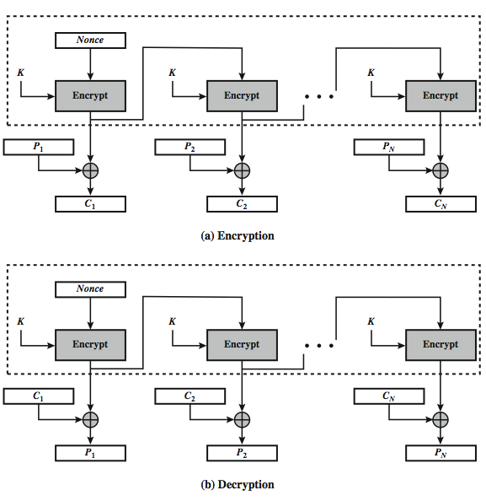
Output FeedBack (OFB)
Notes:
20
Stallings Figure 6.6 illustrates the Output FeedBack (OFB) Mode.

Slide 21
Advantages and Limitations of OFB
needs an IV which is unique for each use
if ever reuse attacker can recover outputs...
OTP
can pre-compute
bit errors do not propagate
more vulnerable to message stream modification...
change arbitrary bits by changing ciphertext
sender & receiver must remain in sync
only use with full block feedback
subsequent research has shown that only full block feedback (ie CFB-64 or CFB-128) should ever be used
Notes:
21
As with CBC and CFB, the OFB mode requires an initialization vector. In the case of OFB, the IV must be a nonce; that is, the IV must be unique to each execution of the encryption operation. The reason for this is that the sequence of encryption output blocks, Oi. , depends only on the key and the IV, and does not depend on the plaintext. Therefore, for a given key and IV, the stream of output bits used to XOR with the stream of plaintext bits is fixed. If two different messages had an identical block of plaintext in the identical position, then an attacker would be able to determine that portion of the O stream.
One advantage of the OFB method is that bit errors in transmission do not propagate. The disadvantage of OFB is that it is more vulnerable to a message stream modification attack than is CFB.
OFB has the structure of a typical stream cipher, in that the cipher generates a stream of bits as a function of an initial value and a key, and that stream of bits is XORed with the plaintext bits. Hence the sender & receiver need to remain in sync, or all data is lost. Also, research has shown that you should only ever use a full block feedback ie OFB-64/128 mode. Hence OFB encrypts plaintext a full block at a time, where typically a block is 64 or 128 bits.

Slide 22
Counter (CTR)
similar to OFB but encrypts counter value rather than any feedback value
O_{i} = E_{K}(i)
C_{i} = P_{i} XOR O_{i}
must have a different key & counter value for every plaintext block (never reused)
again, OTP issue
uses: high-speed network encryptions
Notes:
22
The Counter (CTR) mode is a variant of OFB, but which encrypts a counter value (hence name). Although it was proposed many years before, it has only recently been standardized for use with AES along with the other existing 4 modes. It is being used with applications in ATM (asynchronous transfer mode) network security and IPSec (IP security). A counter, equal to the plaintext block size is used. The only requirement stated in SP 800-38A is that the counter value must be different for each plaintext block that is encrypted. Typically the counter is initialized to some value and then incremented by 1 for each subsequent block. As with the OFB mode, the initial counter value must be a nonce; be different for all of the messages encrypted using the same key. Further, all counter values across all messages must be unique. If, contrary to this requirement, a counter value is used multiple times, then the confidentiality of all of the plaintext blocks corresponding to that counter value may be compromised.

Slide 23
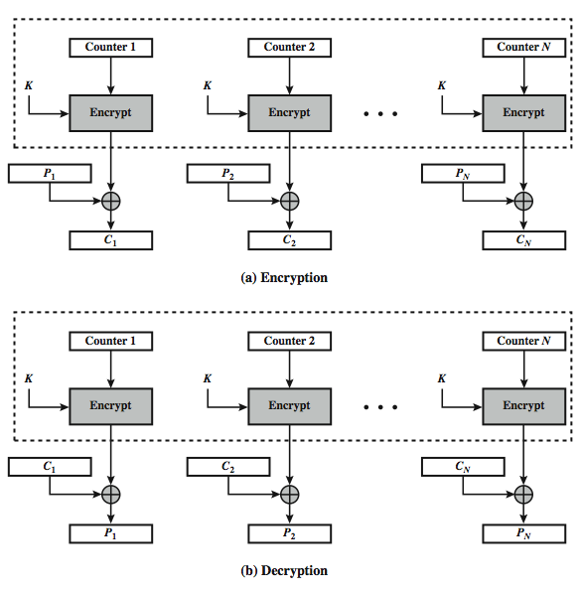
Counter (CTR)
Notes:
23
Stallings Figure 6.7 illustrates the Counter (CTR) Mode.

Slide 24
Advantages and Limitations of CTR
efficiency
can do parallel encryptions in h/w or s/w
can preprocess in advance of need
good for bursty high speed links
random access to encrypted data blocks
provable security (good as other modes)
never have cycle less than 2^{b}
but must ensure never reuse key/counter values, otherwise could break (cf OFB)
Notes:
24
CTR mode has a number of advantages in parallel h/w & s/w efficiency, can preprocess the output values in advance of needing to encrypt, can get random access to encrypted data blocks, and is simple. But like OFB have issue of not reusing the same key+counter value.

Slide 25
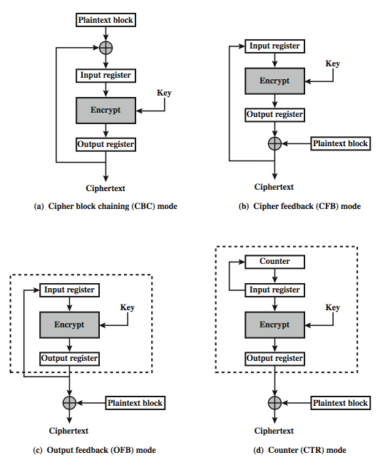
Feedback Character-istics
Notes:
25
Note that, with the exception of ECB, all of the NIST-approved block cipher modes of operation involve feedback. This is clearly seen in Stallings Figure 6.8. To highlight the feedback mechanism, it is useful to think of the encryption function as taking input from a input register whose length equals the encryption block length and with output stored in an output register. The input register is updated one block at a time by the feedback mechanism. After each update, the encryption algorithm is executed, producing a result in the output register. Meanwhile, a block of plaintext is accessed. Note that both OFB and CTR produce output that is independent of both the plaintext and the ciphertext. Thus, they are natural candidates for stream ciphers that encrypt plaintext by XOR one full block at a time.

Slide 26
Stream Ciphers

Slide 27
Random Numbers
many uses of random numbers in cryptography
nonces in authentication protocols to prevent replay
session keys
public key generation
keystream for a one-time pad
in all cases its critical that these values be
statistically random, uniform distribution, independent
unpredictability of future values from previous values
true random numbers provide this
care needed with generated random numbers
Notes:
27
Random numbers play an important role in the use of encryption for various network security applications. In this section, we provide a brief overview of the use of random numbers in cryptography and network security and then focus on the principles of pseudorandom number generation. Getting good random numbers is important, but difficult. You don't want someone guessing the key you're using to protect your communications because your "random numbers" weren't (as happened in an early release of Netscape SSL). Traditionally, the concern in the generation of a sequence of allegedly random numbers has been that the sequence of numbers be random in some well-defined statistical sense (with uniform distribution & independent). In applications such as reciprocal authentication, session key generation, and stream ciphers, the requirement is not just that the sequence of numbers be statistically random but that the successive members of the sequence are unpredictable (so that it is not possible to predict future values having observed previous values). With "true" random sequences, each number is statistically independent of other numbers in the sequence and therefore unpredictable. However, as is discussed shortly, true random numbers are seldom used; rather, sequences of numbers that appear to be random are generated by some algorithm.

Slide 28
Pseudorandom Number Generators (PRNGs)
often use deterministic algorithmic techniques to create “random numbers”
although are not truly random
can pass many tests of “randomness”
known as “pseudorandom numbers”
created by “Pseudorandom Number Generators (PRNGs)”
Notes:
28
Cryptographic applications typically make use of deterministic algorithmic techniques for random number generation, producing sequences of numbers that are not statistically random, but if the algorithm is good, the resulting sequences will pass many reasonable tests of randomness. Such numbers are referred to as pseudorandom numbers, created by “Pseudorandom Number Generators (PRNGs)”.

Slide 29
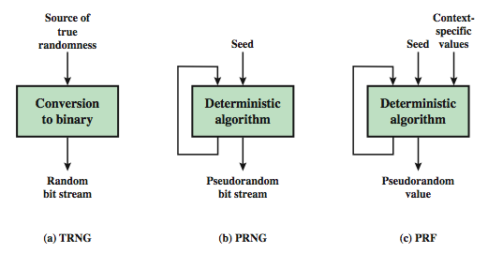
Notes:
Stallings Figure 7.1 contrasts a true random number generator (TRNG) with two forms of pseudorandom number generators. A TRNG takes as input a source that is effectively random; the source is often referred to as an entropy source. In contrast, a PRNG takes as input a fixed value, called the seed, and produces a sequence of output bits using a deterministic algorithm. Typically, as shown, there is some feedback path by which some of the results of the algorithm are fed back as input as additional output bits are produced. The important thing to note is that the output bit stream is determined solely by the input value or values, so that an adversary who knows the algorithm and the seed can reproduce the entire bit stream.
Figure 7.1 shows two different forms of PRNGs, based on application;
• Pseudorandom number generator: An algorithm that is used to produce an open-ended sequence of bits is referred to as a PRNG. A common application for an open-ended sequence of bits is as input to a symmetric stream cipher, as discussed in Section 7.4. Also, see Figure 3.1a.
• Pseudorandom function (PRF): A PRF is used to produced a pseudorandom string of bits of some fixed length. Examples are the symmetric encryption keys and nonces. Typically, the PRF takes as input a seed plus some context specific values, such as a user ID or an application ID.
29

Slide 30
PRNG Requirements
randomness
uniformity, scalability, consistency
unpredictability
forward & backward unpredictability
use same tests to check
characteristics of the seed
secure
if known adversary can determine output
so must be random or pseudorandom number
Notes:
When a PRNG or PRF is used for a cryptographic application, then the basic requirement is that an adversary who does not know the seed is unable to determine the pseudorandom string. This general requirement for secrecy of the output of a PRNG or PRF leads to specific requirements in the areas of randomness, unpredictability, and the characteristics of the seed.
In terms of randomness, the requirement for a PRNG is that the generated bit stream appear random even though it is deterministic. NIST SP 800-22 (A Statistical Test Suite for Random and Pseudorandom Number Generators for Cryptographic Applications) specifies that the tests should seek to establish the following three characteristics: uniformity, scalability, consistency. SP 800-22 lists 15 separate tests of randomness.
A stream of pseudorandom numbers should exhibit two forms of unpredictability: forward unpredictability, backward unpredictability. The same set of tests for randomness also provide a test of unpredictability. If the generated bit stream appears random, then it is not possible to predict some bit or bit sequence from knowledge of any previous bits. Similarly, if the bit sequence appears random, then there is no feasible way to deduce the seed based on the bit sequence. That is, a random sequence will have no correlation with a fixed value (the seed).
For cryptographic applications, the seed that serves as input to the PRNG must be secure. Because the PRNG is a deterministic algorithm, if the adversary can deduce the seed, then the output can also be determined. Therefore, the seed must be unpredictable. In fact, the seed itself must be a random or pseudorandom number.
30

Slide 31
Linear Congruential Generator
common iterative technique using:
X_{n+1} = (aX_{n} + c) mod m
given suitable values of parameters can produce a long random-like sequence
suitable criteria to have are:
function generates a full-period
generated sequence should appear random
efficient implementation with 32-bit arithmetic
note that an attacker can reconstruct sequence given a small number of values
have possibilities for making this harder
Notes:
31
By far the most widely used technique for pseudorandom number generation is the “Linear Congruential Generator”, first proposed by Lehmer. It uses successive values from an iterative equation. Given suitable values of parameters can produce a long random-like sequence, but there are only a small number of such good choices. Note that the sequence, whilst looking random, is highly predictable, and an attacker can reconstruct the sequence knowing only a small number of values. There are some approaches to making this harder to do in practice by modifying the numbers in some way, see text.

Slide 32
Blum Blum Shub Generator
based on public key algorithms
use least significant bit from iterative equation:
x_{i} = x_{i-1}² mod n
where n=p.q, and primes p,q=3 mod 4
unpredictable, passes next-bit test
security rests on difficulty of factoring N
is unpredictable given any run of bits
slow, since very large numbers must be used
too slow for cipher use, good for key generation
Notes:
32
A popular approach to generating secure pseudorandom number is known as the Blum, Blum, Shub (BBS) generator, after its developers [BLUM86]. It has perhaps the strongest public proof of its cryptographic strength of any PRNG. It is based on public key algorithms, and hence is very slow, but has a very high level of security. It is referred to as a cryptographically secure pseudorandom bit generator (CSPRBG), being in practice unpredictable.

Slide 33
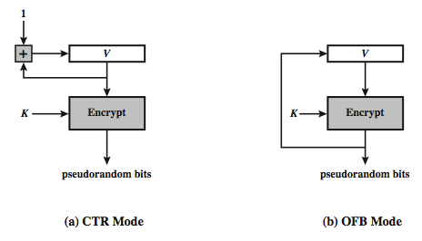
Using Block Ciphers as PRNGs
for cryptographic applications, can use a block cipher to generate random numbers
often for creating session keys from master key
CTR
X_{i} = E_{K}[V_{i}]
OFB
X_{i} = E_{K}[X_{i-1}]
Notes:
33
A popular approach to PRNG construction is to use a symmetric block cipher as the heart of the PRNG mechanism. For any block of plaintext, a symmetric block cipher produces an output block that is apparently random. That is, there are no patterns or regularities in the ciphertext that provide information that can be used to deduce the plaintext. Thus, a symmetric block cipher is a good candidate for building a pseudorandom number generator. If an established, standardized block cipher is used, such as DES or AES, then the security characteristics of the PRNG can be established. Further, many applications already make use of DES or AES, so the inclusion of the block cipher as part of the PRNG algorithm is straightforward. Two approaches that use a block cipher to build a PNRG have gained widespread acceptance: the CTR mode and the OFB mode. The CTR mode is recommended in SP 800-90, in the ANSI standard X9.82 (Random Number Generation), and RFC 4086. The OFB mode is recommended in X9.82 and RFC 4086. Stallings Figure 7.3 illustrates the two methods. In each case, the seed consists of two parts: the encryption key value and a value V that will be updated after each block of pseudorandom numbers is generated. In the CTR case, the value of V is incremented by 1 after each encryption. In the case of OFV, the value of V is updated to equal the value of the preceding PRNG block. In both cases, pseudorandom bits are produced on block at a time.

Slide 34
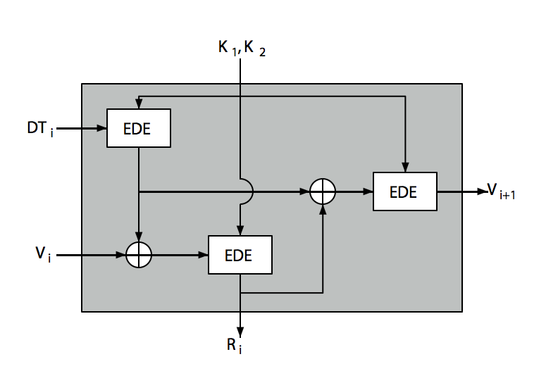
ANSI X9.17 PRG
Notes:
34
One of the strongest (cryptographically speaking) PRNGs is specified in ANSI X9.17. It uses date/time & seed inputs and 3 triple-DES encryptions to generate a new seed & random value. See discussion & illustration in Stallings section 7.3 & Figure 7.4 where:
DTi - Date/time value at the beginning of ith generation stage
Vi - Seed value at the beginning of ith generation stage
Ri - Pseudorandom number produced by the ith generation stage
K1, K2 - DES keys used for each stage
Then compute successive values as:
Ri = EDE([K1, K2], [Vi XOR EDE([K1, K2], DTi)])
Vi+1 = EDE([K1, K2], [Ri XOR EDE([K1, K2], DTi)])
Several factors contribute to the cryptographic strength of this method. The technique involves a 112-bit key and three EDE encryptions for a total of nine DES encryptions. The scheme is driven by two pseudorandom inputs, the date and time value, and a seed produced by the generator that is distinct from the pseudo-random number produced by the generator. Thus the amount of material that must be compromised by an opponent is overwhelming.

Slide 35
Stream Ciphers
process message bit by bit (as a stream)
have a pseudo random keystream
combined (XOR) with plaintext bit by bit
randomness of stream key completely destroys statistically properties in message
C_{i} = M_{i} XOR StreamKey_{i}
but must never reuse stream key
otherwise can recover messages (cf book cipher)
Notes:
35
A typical stream cipher encrypts plaintext one byte at a time, although a stream cipher may be designed to operate on one bit at a time or on units larger than a byte at a time. In a stream cipher, a key is input to a pseudorandom bit generator that produces a stream of 8-bit numbers that are apparently random. The output of the generator, called a keystream, is combined one byte at a time with the plaintext stream using the bitwise exclusive-OR (XOR) operation. The stream cipher is similar to the one-time pad discussed in Chapter 2. The difference is that a one-time pad uses a genuine random number stream, whereas a stream cipher uses a pseudorandom number stream. But rely on the randomness of stream key completely destroys statistically properties in message. However, you must never reuse a stream key since otherwise you can recover messages (as with a book cipher).

Slide 36
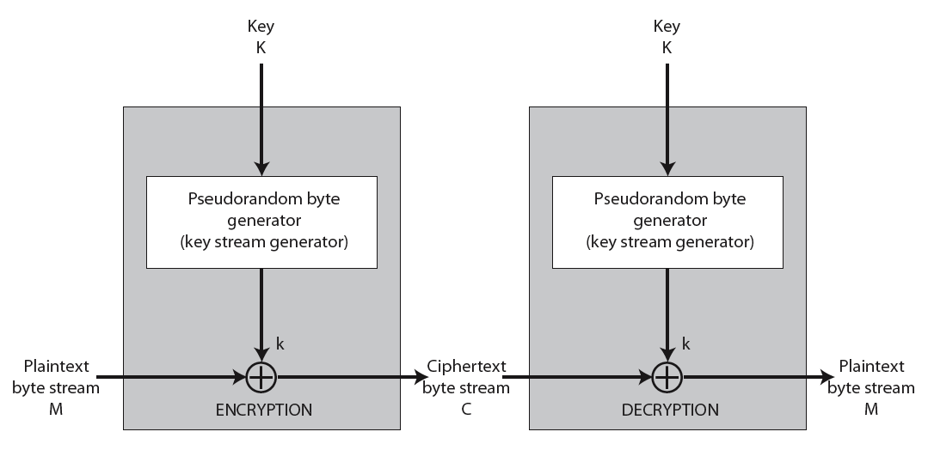
Stream Cipher Structure
Notes:
36
Stallings Figure 7.5 illustrates the general structure of a stream cipher, where a key is input to a pseudorandom bit generator that produces an apparently random keystream of bits, and which are XOR’d with message to encrypt it, and XOR’d again to decrypt it by the receiver.

Slide 37
Stream Cipher Properties
some design considerations are:
long period with no repetitions
statistically random
depends on large enough key
large linear complexity
properly designed, can be as secure as a block cipher with same size key
but usually simpler & faster
Notes:
37
[KUMA97] lists the following important design considerations for a stream cipher:
The encryption sequence should have a large period, the longer the period of repeat the more difficult it will be to do cryptanalysis.
The keystream should approximate the properties of a true random number stream as close as possible, the more random-appearing the keystream is, the more randomized the ciphertext is, making cryptanalysis more difficult.
To guard against brute-force attacks, the key needs to be sufficiently long. The same considerations as apply for block ciphers are valid here .Thus, with current technology, a key length of at least 128 bits is desirable.
With a properly designed pseudorandom number generator, a stream cipher can be as secure as block cipher of comparable key length. The primary advantage of a stream cipher is that stream ciphers are almost always faster and use far less code than do block ciphers. A stream cipher can be constructed with any cryptographically strong PRNG.

Slide 38
RC4
a proprietary cipher owned by RSA DSI
another Ron Rivest design, simple but effective
variable key size, byte-oriented stream cipher
widely used (web SSL/TLS, wireless WEP/WPA)
key forms random permutation of all 8-bit values
uses that permutation to scramble input info processed a byte at a time
Notes:
38
RC4 is a stream cipher designed in 1987 by Ron Rivest for RSA Security. It is a variable key-size stream cipher with byte-oriented operations. The algorithm is based on the use of a random permutation. Analysis shows that the period of the cipher is overwhelmingly likely to be greater than 10^100. Eight to sixteen machine operations are required per output byte, and the cipher can be expected to run very quickly in software. RC4 is probably the most widely used stream cipher. It is used in the SSL/TLS secure web protocol, & in the WEP & WPA wireless LAN security protocols. RC4 was kept as a trade secret by RSA Security, but in September 1994 was anonymously posted on the Internet on the Cypherpunks anonymous remailers list. In brief, the RC4 key is ued to form a random permutation of all 8-bit values, it then uses that permutation to scramble input info processed a byte at a time.

Slide 39
RC4 Key Schedule
starts with an array S of numbers: 0..255
use key to well and truly shuffle
S forms internal state of the cipher
for i = 0 to 255 do
S[i] = i
T[i] = K[i mod keylen])
j = 0
for i = 0 to 255 do
j = (j + S[i] + T[i]) (mod 256)
swap (S[i], S[j])
Notes:
39
The RC4 algorithm is remarkably simple and quite easy to explain. It uses a variable-length key of from 1 to 256 bytes. The RC4 key schedule initialises the state S to the numbers 0..255, and then walks through each entry in turn, using its current value plus the next byte of key to pick another entry in the array, and swaps their values over. After doing this 256 times, the result is a well and truly shuffled array. The total number of possible states is 256! - a truly enormous number, much larger even than the 2048-bit (256*8) max key allowed can select.

Slide 40
RC4 Encryption
encryption continues shuffling array values
sum of shuffled pair selects "stream key" value from permutation
XOR S[t] with next byte of message to en/decrypt
i = j = 0
for each message byte M_{i}
i = (i + 1) (mod 256)
j = (j + S[i]) (mod 256)
swap(S[i], S[j])
t = (S[i] + S[j]) (mod 256)
C_{i} = M_{i} XOR S[t]
Notes:
40
To form the stream key for en/decryption (which are identical), RC4 continues to shuffle the permutation array S by continuing to swap each element in turn with some other entry, and using the sum of these two entry values to select another value from the permutation to use as the stream key, which is then XOR’d with the current message byte.

Slide 41
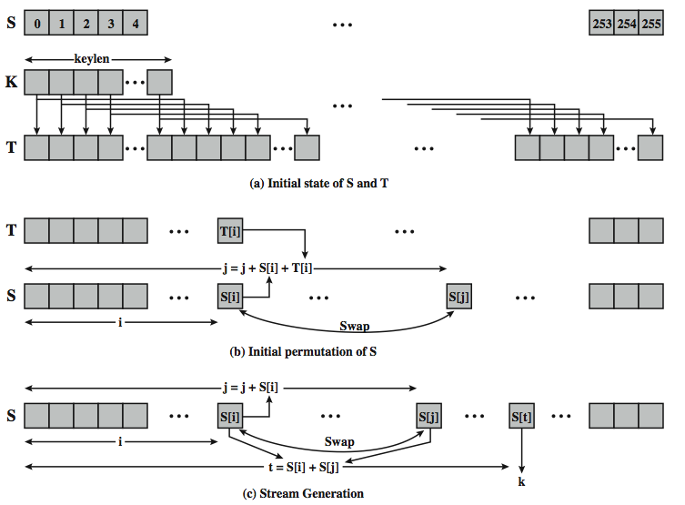
RC4 Overview
Notes:
41
Stallings Figure 7.6 illustrates the general structure of RC4.

Slide 42
https://www.youtube.com/watch?v=KM-xZYZXElk
http://www.asciitable.com/

Slide 43
RC4 Security
claimed secure against known attacks
have some analyses, none practical
result is very non-linear
since RC4 is a stream cipher, must never reuse a key
have a concern with WEP, but due to key handling rather than RC4 itself
Notes:
43
A number of papers have been published analyzing methods of attacking RC4, but none of these approaches is practical against RC4 with a reasonable key length, such as 128 bits.
A more serious problem occurs in its use in the WEP protocol, not with RC4 itself but the way in which keys are generated for use as input to RC4.
Currently RC4 its regarded as quite secure, if used correctly, with a sufficiently large key.

Slide 44
RC4 and WEP
WEP is a protocol using RC4 to encrypt packets for transmission over IEEE 802.11 wireless LAN.
WEP requires each packet to be encrypted with a separate RC4 key.
The RC4 key for each packet is a concatenation of a 24-bit IV (initialization vector) and a 40 or 104-bit long-term key.
RC4 key: IV (24) Long-term key (40 or 104 bits)
l

Slide 45
802.11 frames using WEP
datagram
l
Header IV Packet ICV FCS
encrypted
ICV: integrity check value (for data integrity)
FCS: frame check sequence (for error detection)
Both use CRC32
Notes:
Datagram -> basic unit of information transferred.

Slide 46
WEP has been shown to be insecure.
There is an article, “Breaking 104 bit WEP in less than 60 seconds,” discussing how to discover the RC4 key by analyzing encrypted ARP packets.

